Slide 1

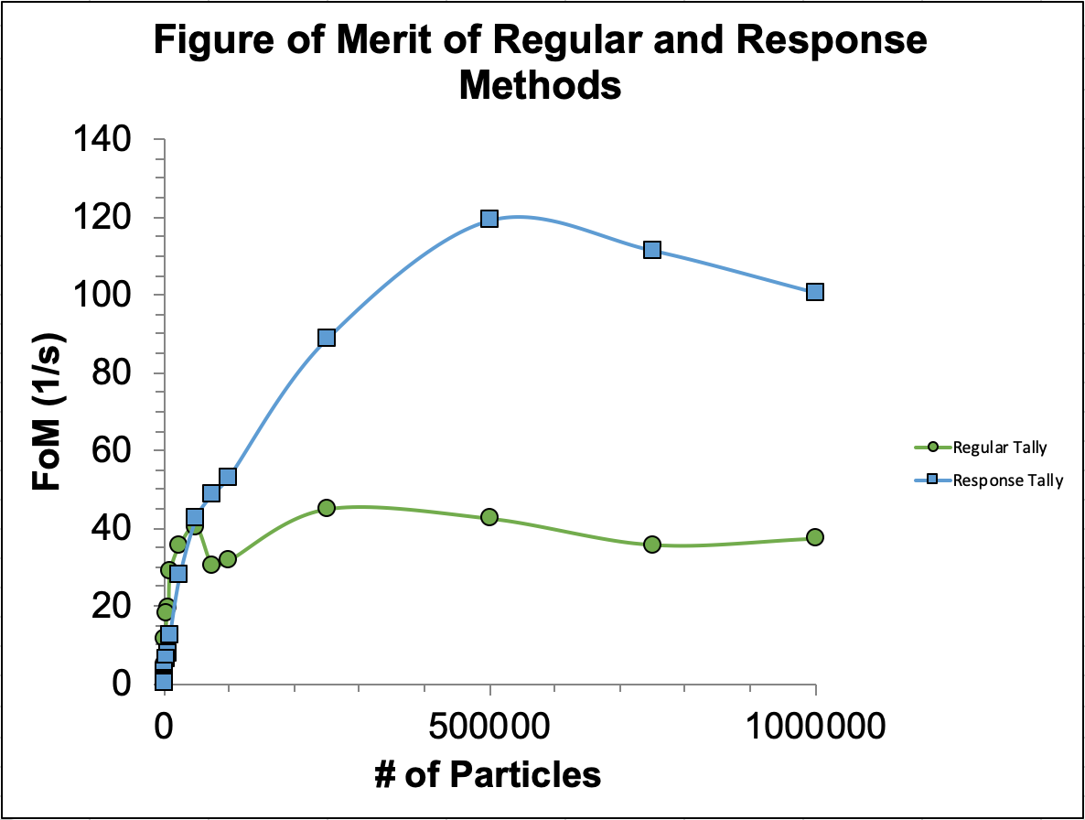
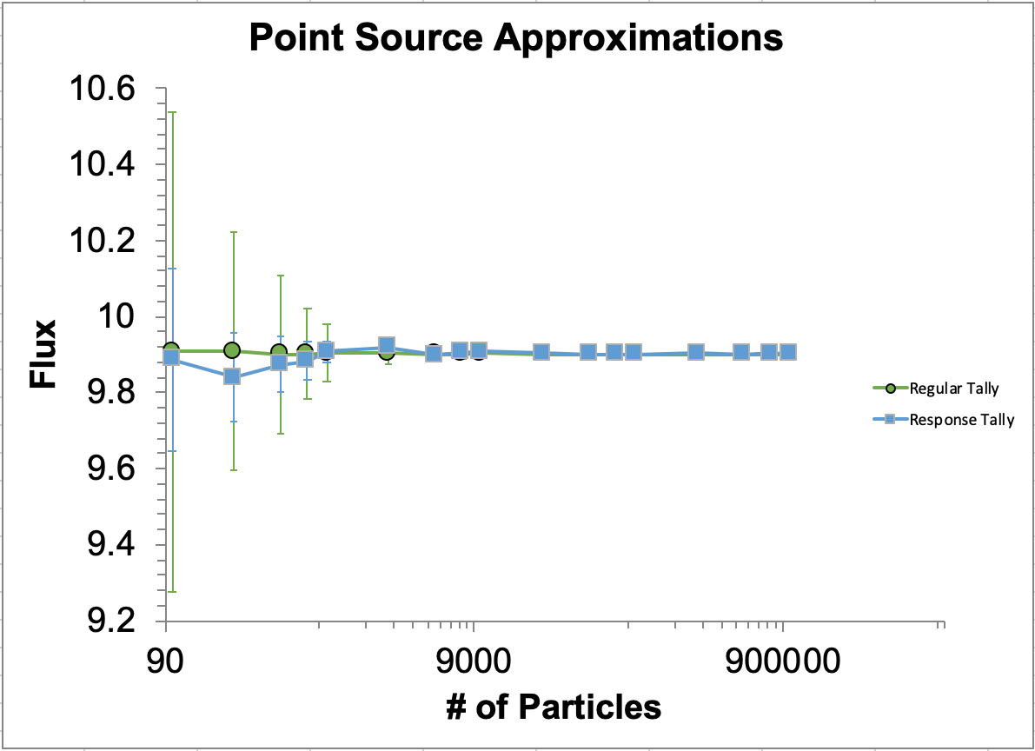
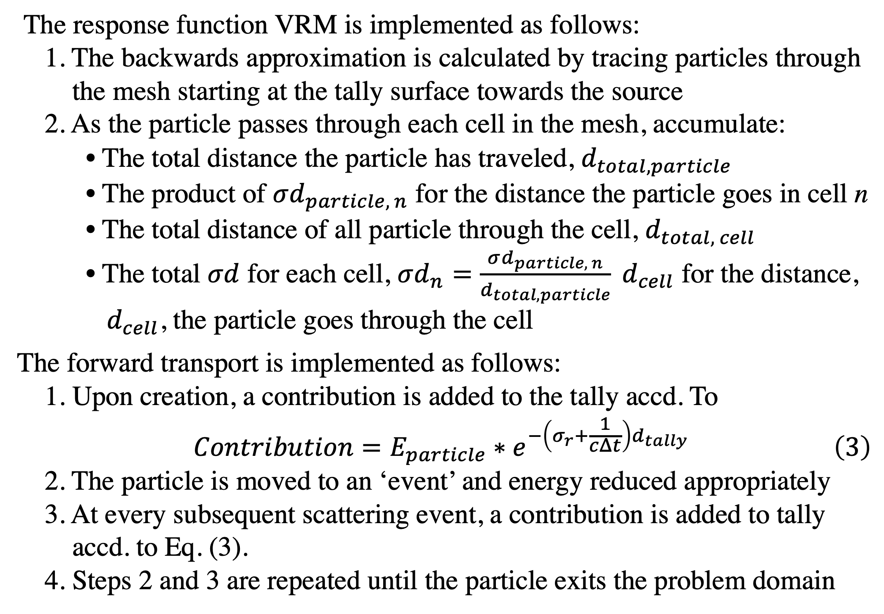
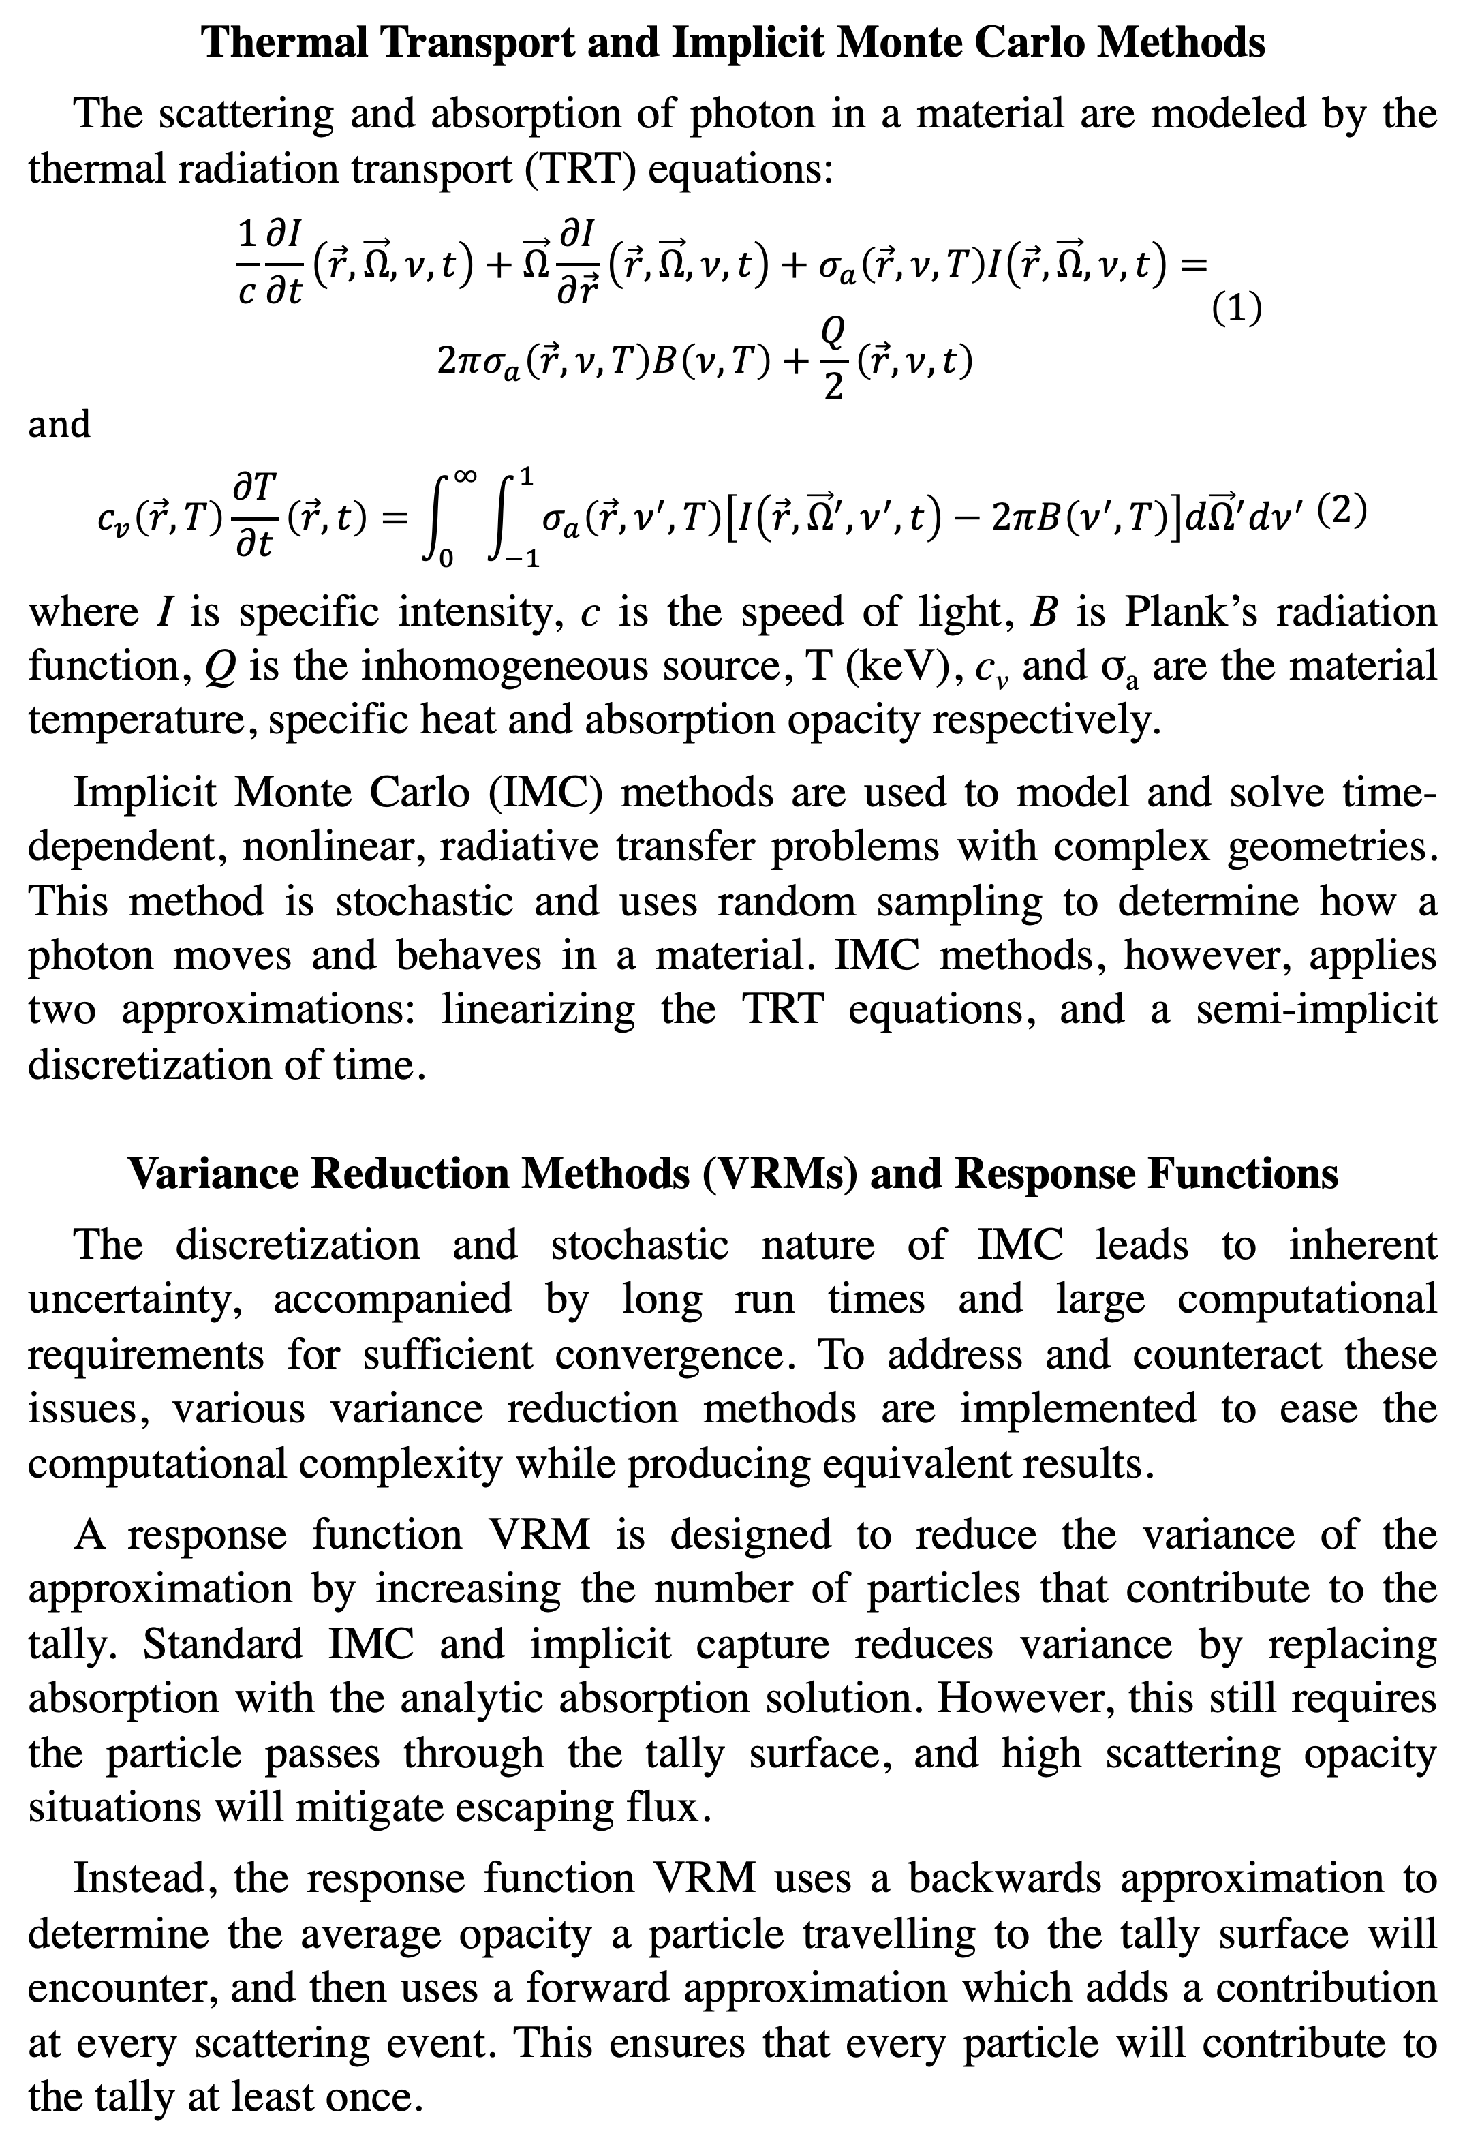
Variance Reduction at Scale: Response Function Methods
for IMC Thermal Transport Problems
Scott Campbell, Gonzaga University
Mentors: Mathew Cleveland, Kendra Long, Ryan Wollaeger
Introduction & Background
Method
Thermal Transport and Implicit Monte Carlo Methods
The scattering and absorption of photon in a material are modeled by the thermal radiation transport (TRT) equations:
$$\begin{aligned}\begin{aligned} \frac{1}{c}\frac{∂I}{∂t}\left(\vec{r}, \vec{Ω}, ν, t\right)+\vec{Ω}\frac{∂I}{∂\vec{r}}\left(\vec{r}, \vec{Ω}, ν, t\right)+σ_{a}\left(\vec{r}, ν,T\right)I\left(\vec{r},\vec{Ω}, ν,t\right)= \\ 2πσ_{a}\left(\vec{r},ν,T\right)B\left(ν, T\right)+\frac{Q}{2}\left(\vec{r},ν, t\right)\end{aligned}\#\left(1\right)\end{aligned}$$
and
$$\begin{aligned}\begin{aligned}\begin{aligned} \\ c_{v}\left(\vec{r},T\right)\frac{∂T}{∂t}\left(\vec{r},t\right)=\int_{0}^{∞}{\int_{−1}^{1}{σ_{a}\left(\vec{r},ν^{′}, T\right)\left[I\left(\vec{r},{\vec{Ω}}^{′},ν^{′},t\right)−2πB\left(ν^{′},T\right)\right]d{\vec{Ω}}^{′}dν^{′}}} \#\end{aligned}\end{aligned}\#\left(2\right)\end{aligned}$$
where I is specific intensity, c is the speed of light, B is Plank’s radiation function, Q is the inhomogeneous source, T (keV), c_{v} and σ_{a} are the material temperature, specific heat and absorption opacity respectively.
Implicit Monte Carlo (IMC) methods are used to model and solve time-dependent, nonlinear, radiative transfer problems with complex geometries. This method is stochastic and uses random sampling to determine how a photon moves and behaves in a material. IMC methods, however, applies two approximations: linearizing the TRT equations, and a semi-implicit discretization of time.
Variance Reduction Methods (VRMs) and Response Functions
The discretization and stochastic nature of IMC leads to inherent uncertainty, accompanied by long run times and large computational requirements for sufficient convergence. To address and counteract these issues, various variance reduction methods are implemented to ease the computational complexity while producing equivalent results.
A response function VRM is designed to reduce the variance of the approximation by increasing the number of particles that contribute to the tally. Standard IMC and implicit capture reduces variance by replacing absorption with the analytic absorption solution. However, this still requires the particle passes through the tally surface, and high scattering opacity situations will mitigate escaping flux.
Instead, the response function VRM uses a backwards approximation to determine the average opacity a particle travelling to the tally surface will encounter, and then uses a forward approximation which adds a contribution at every scattering event. This ensures that every particle will contribute to the tally at least once.
The response function VRM is implemented as follows:
1. The backwards approximation is calculated by tracing particles through
the mesh starting at the tally surface towards the source
2. As the particle passes through each cell in the mesh, accumulate:
• The total distance the particle has traveled, $d_{total,particle}$
• The product of $σd_{particle, n}$ for the distance the particle goes in cell n
• The total distance of all particle through the cell, $d_{total, cell}$
• The total $σd$ for each cell, $σd_{n}=\frac{σd_{particle, n}}{d_{total, particle}} d_{cell}$ for the distance,
$d_{cell}$, the particle goes through the cell
The forward transport is implemented as follows:
1. Upon creation, a contribution is added to the tally accd. To
$$\begin{aligned}Contribution=E_{particle}∗e^{−\left(σ_{r}+\frac{1}{cΔt}\right)d_{tally}} \#\left(3\right)\end{aligned}$$
2. The particle is moved to an ‘event’ and energy reduced appropriately
3. At every subsequent scattering event, a contribution is added to tally
accd. to Eq. (3).
4. Steps 2 and 3 are repeated until the particle exits the problem domain
Results
Figure 1:
A graph showing the figure of merits (FoM) of the regular tally method as well as the response function. A higher FoM corresponds to a method that provides less variance in a more efficient span of time. This figure shows that after approx. 50k particles, our method results in a significantly improved FoM compared to a regular tally. This provides a strong basis for the usefulness of our method.
Figure 2:
A graph showing the average values of the flux for a point source problem as well as the accompanying variance as a function of the number of particles used in the simulation. This shows that our method has far less variance for fewer simulated particles, which implies that it is a more reliable method under these conditions.
Conclusions
Research Objective
The objective of this research project is to investigate the advantages and drawbacks of a response function VRM for IMC simulations using the open source IMC code Branson developed by Alex Long. The method is then to be applied to events such as multidimensional supernova transients, and comparing the simulation results to physical observations.
Additionally, the project investigates the figure of merit of the response function VRM as well as the cases in which the method breaks down. This is accomplished by analyzing the method results over a range of problems and looking at the variance of the standard vs response function based methods.
Los Alamos National Laboratory

